Slide 1
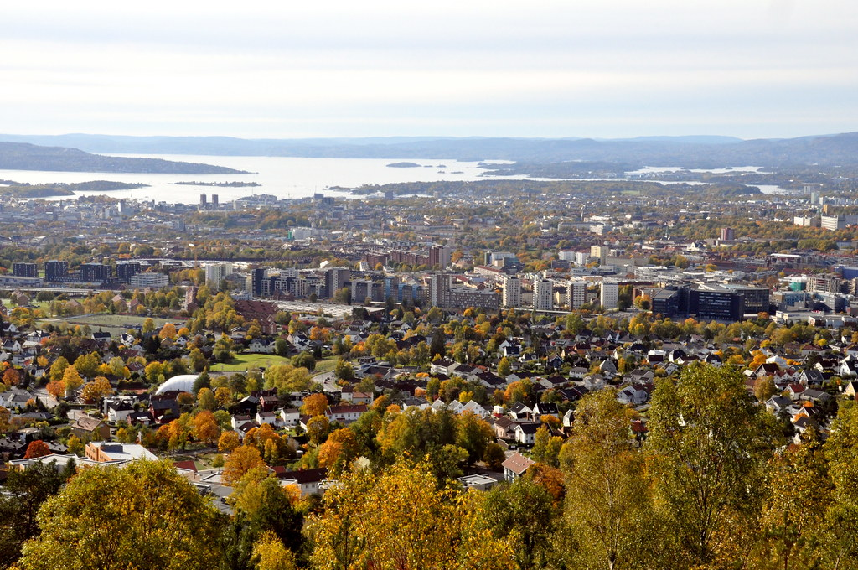
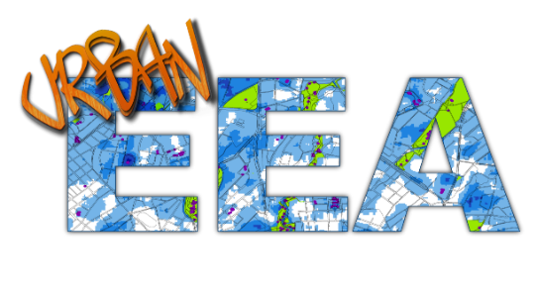
Tree spotting
-mapping the urban tree canopy
Frank Hanssen
URBAN EEA Conference
Oslo March 18.th 2020
Photo: Inge Knoff (CC BY-NC 2.0)

Slide 2
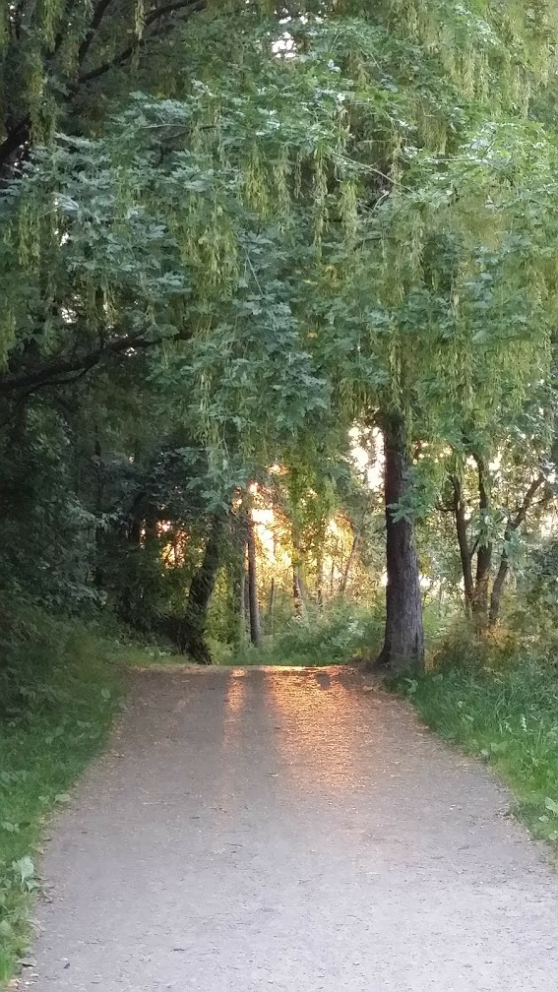
Context: The Oslo City Council aims to plant 100 000 new trees by 2030
How to account the achievement of this goal from using LIDAR-data?
What are the patterns of development from 2011 to 2017 in the built-up area of Oslo?
What are the application, limitations and uncertainity of our results?
Some reccomendations for future tree canopy mapping
Outline
Photo: Frank Hanssen (CC BY-NC 2.0)

Slide 3
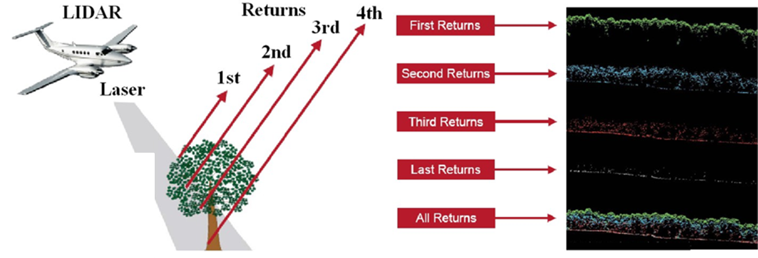
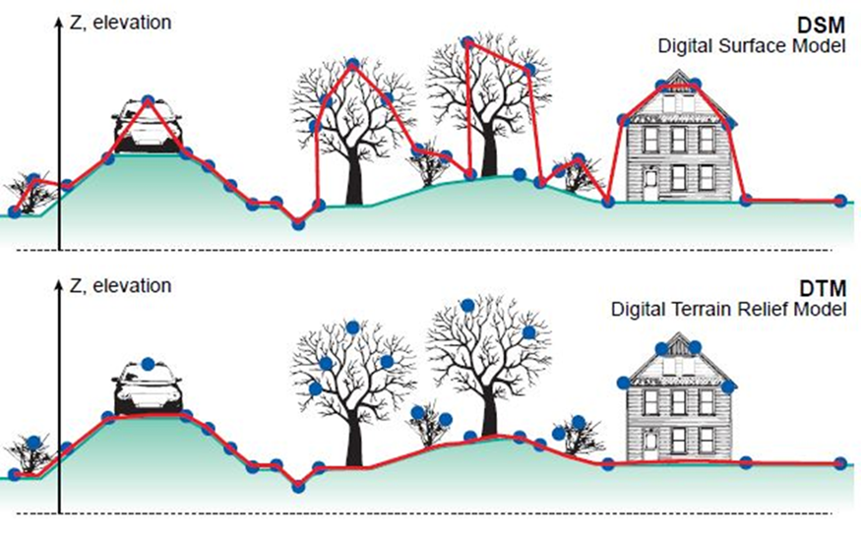
Data and
methodology

Slide 4
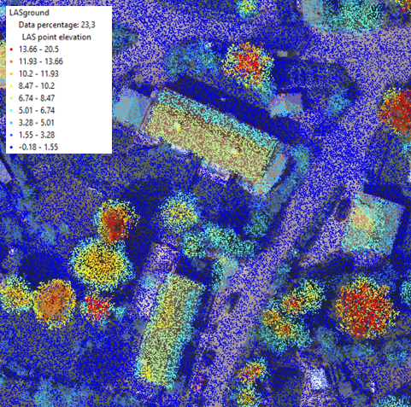
 | Average point density per m² | Point classification
Oslo 2011 | 43 | 1-2-3-4-5-7-9-10-24
Oslo 2014 | 25 | 1-2-7-10
Oslo 2017 | 10 | 1-2-7-10-13
Point category | Categories
1 | Unclassified
2 | Ground
3 | Low vegetation
4 | Medium vegetation
5 | High vegetation
7 | Outliers (noise)
9 | Water
10 | Points on bridge
13 | Wire-guard (shield)
24 | Power line
Data source: https://hoydedata.no/LaserInnsyn/

Slide 5
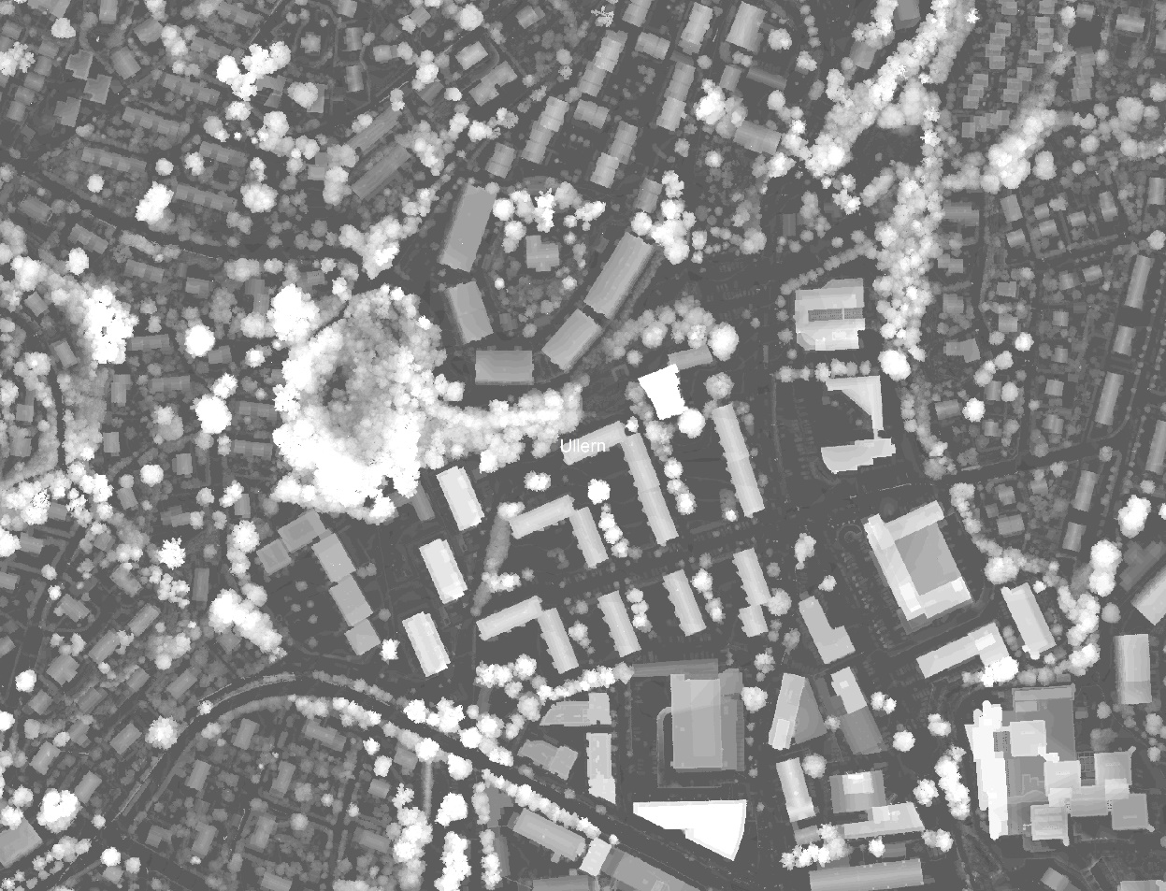
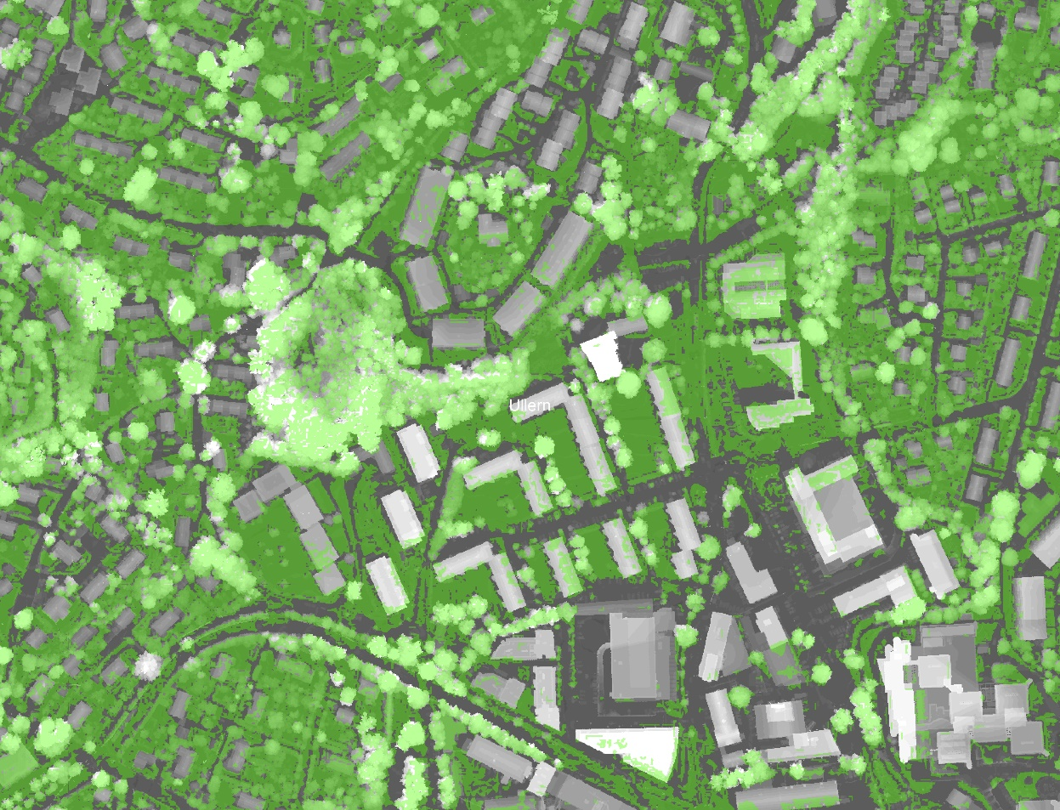
Estimation of tree canopy (1/2)
Canopy Height Model (CHM)
CHM and vegetation mask

Slide 6
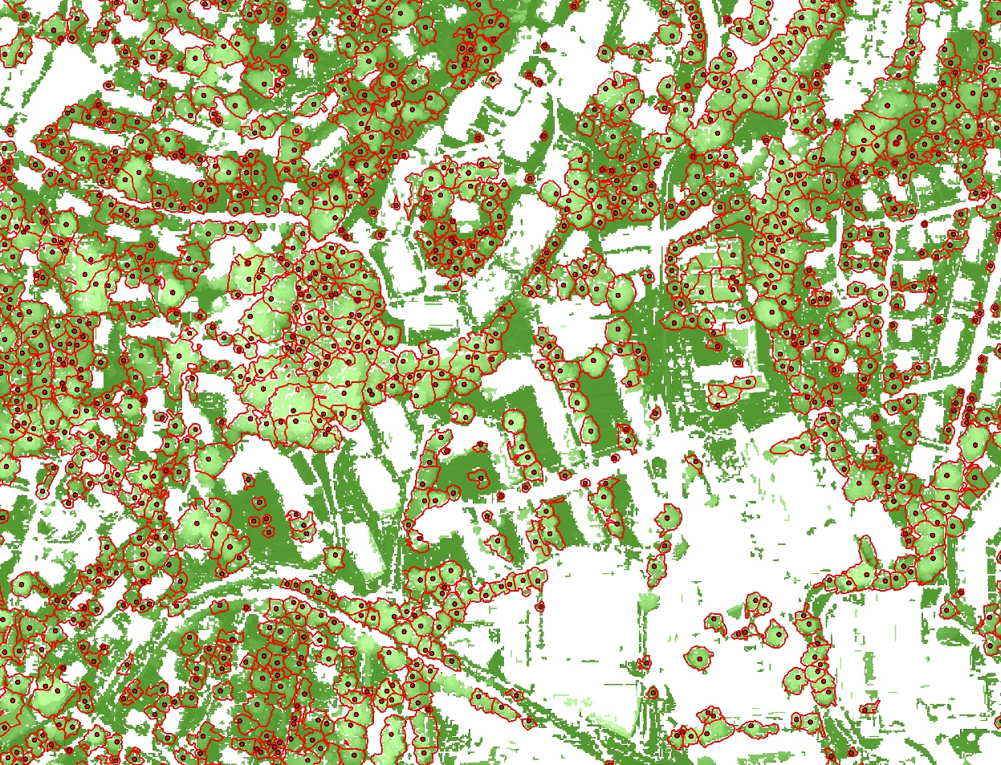
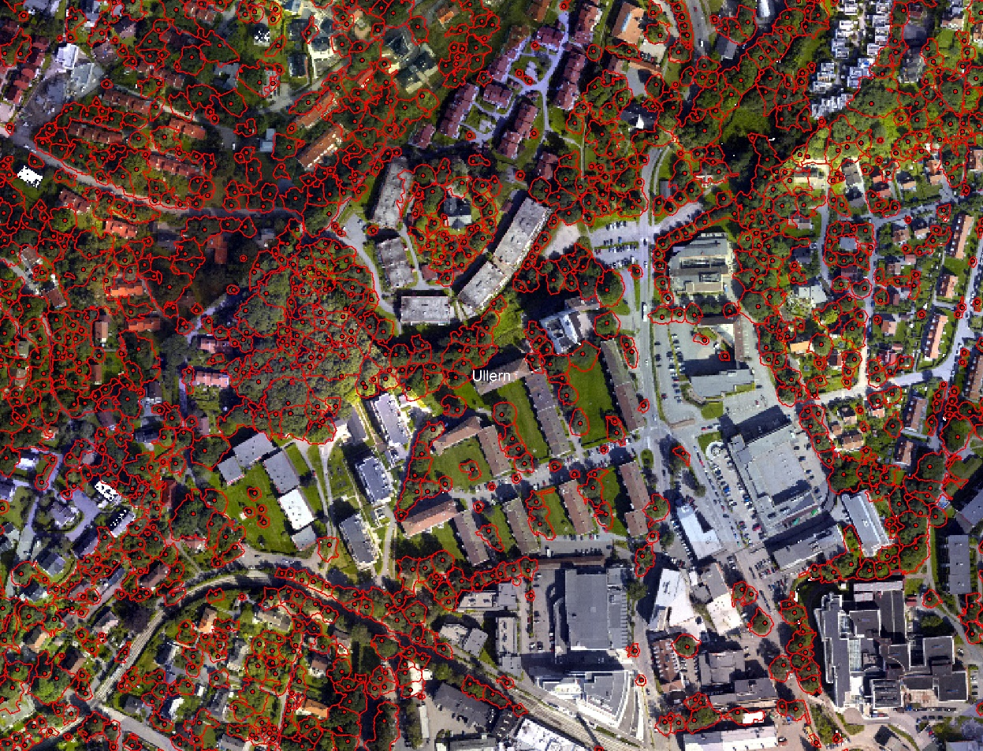
Estimation of tree canopy (2/2)
Segmented tree canopies
Segmented tree canopies masked for technical infra-structure (buildings, powerlines, poles, signs, etc).

Slide 7
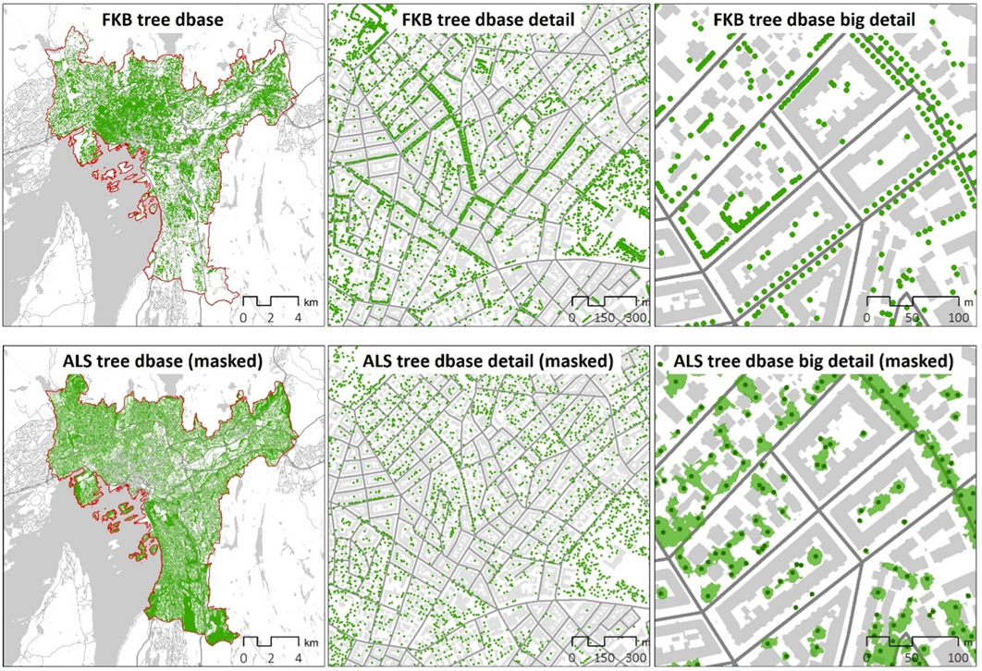
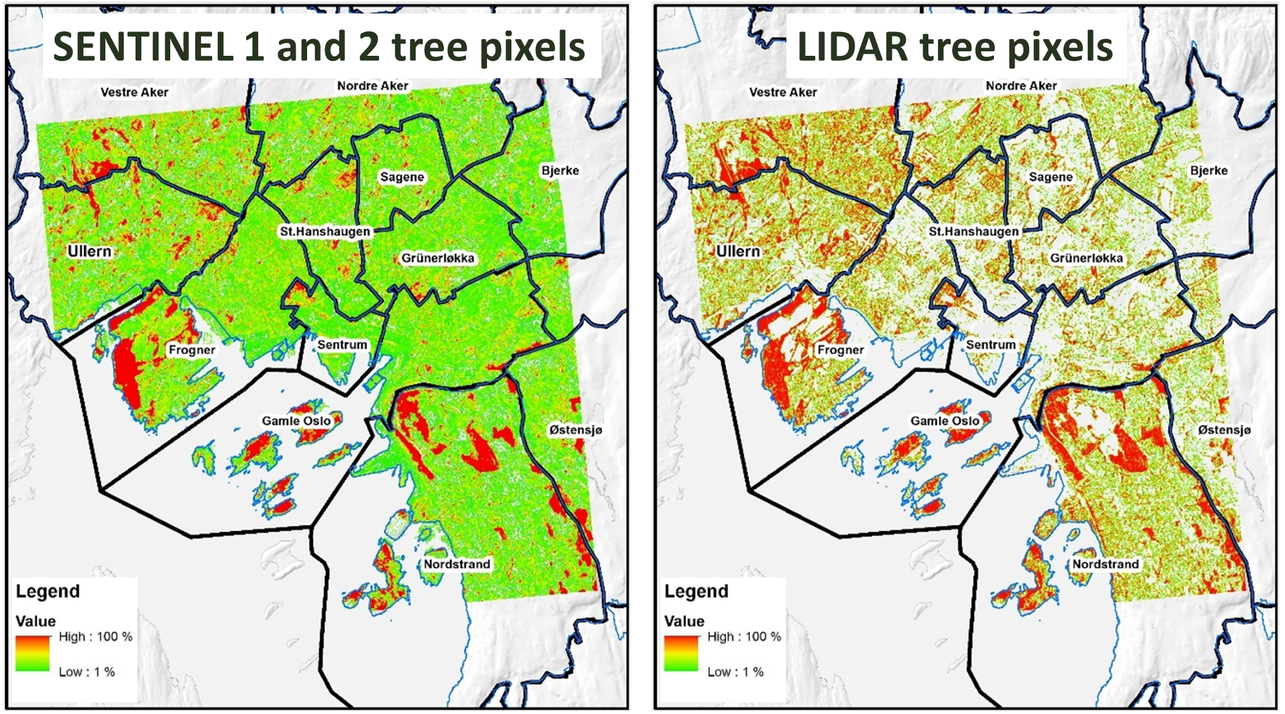
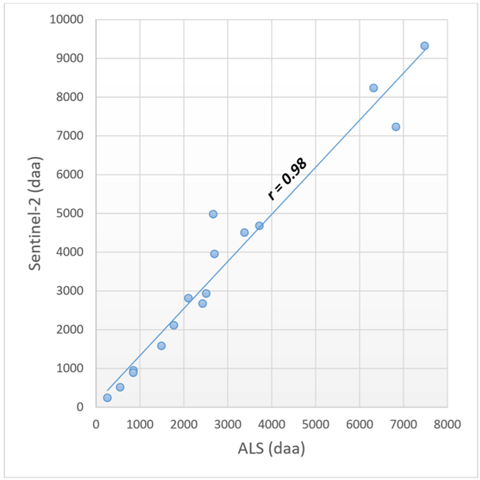
Validation
At single tree level
Underestimation in number of trees compared to PBE field data (70 % overlap)
Local overestimation of tree canopy area compared to Sentinel 2
At aggregated level
High correlation of tree canopy area compared to Sentinel 2 at city-district level
Hanssen et al. (2018). Mapping urban tree canopy cover using airborne laser scanning- applications to urban ecosystem accounting for Oslo. NINA-report 1677

Slide 8
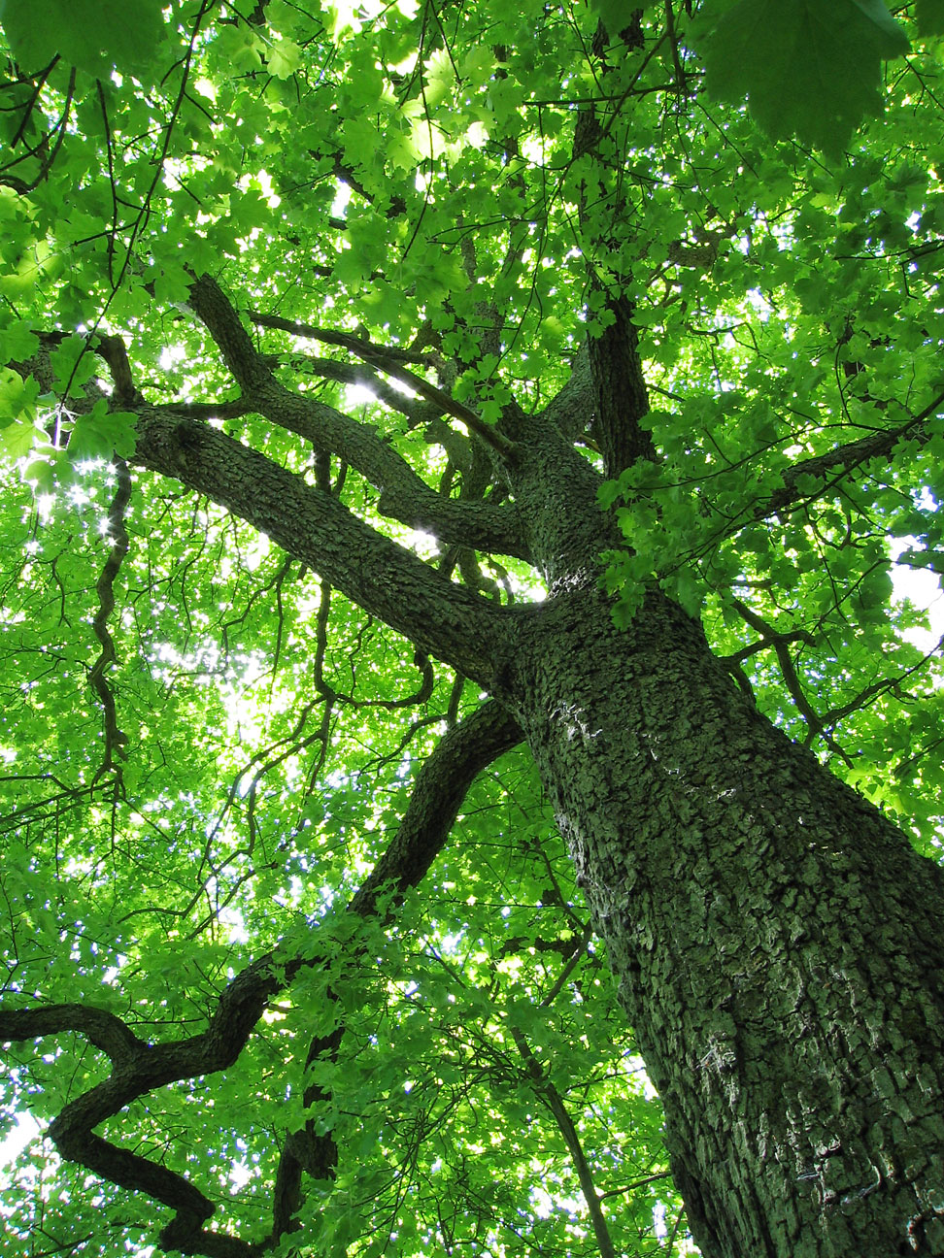
So, how to account the achievement of the 2030 goal?
.. and what are the patterns of development (2011-2017)?
Results
Photo: Unknown (CC BY-SA)

Slide 9
Status in the built-up area compared to the 2030-goal
(2017 trees + 100 000 new trees = 100 %)
No. of
trees
Crown
area
2011
2014
2017

Slide 11
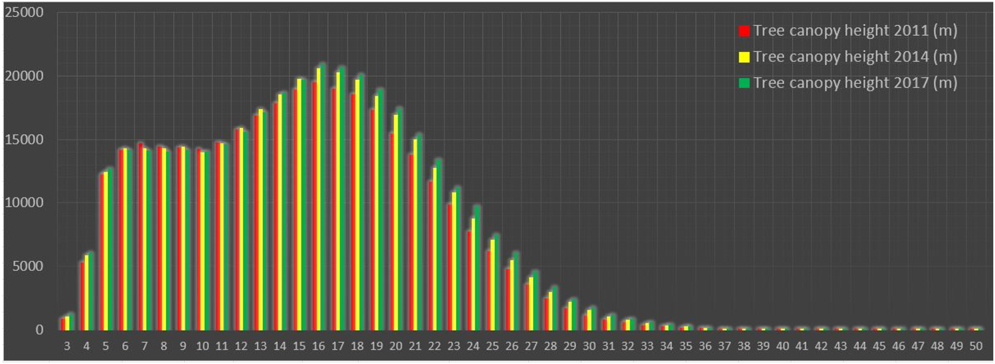
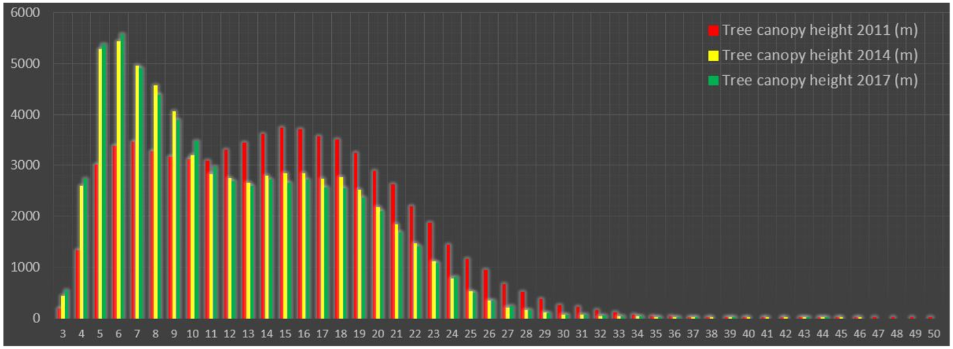
Number of trees in the «built-up» area
Median height 2011: 15
Median height 2014: 15
Median height 2011: 16
Number of tree in the «småhusplan» area of Oslo
Median height 2011: 14
Median height 2014: 11
Median height 2011: 11
Hanssen et al. (2018). Mapping urban tree canopy cover using airborne
laser scanning- applications to urban ecosystem accounting for Oslo.

Slide 13
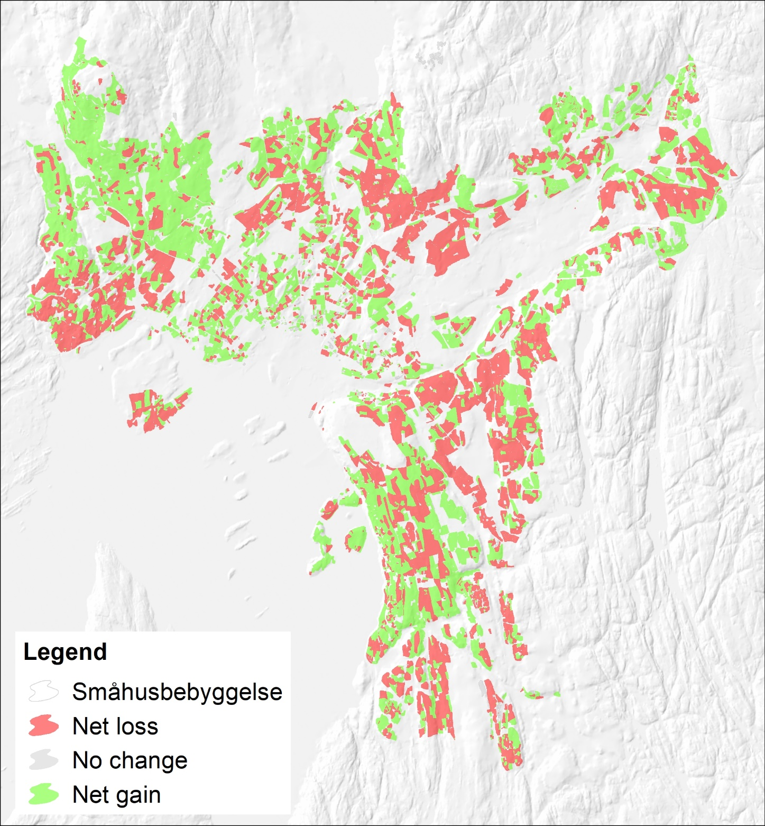
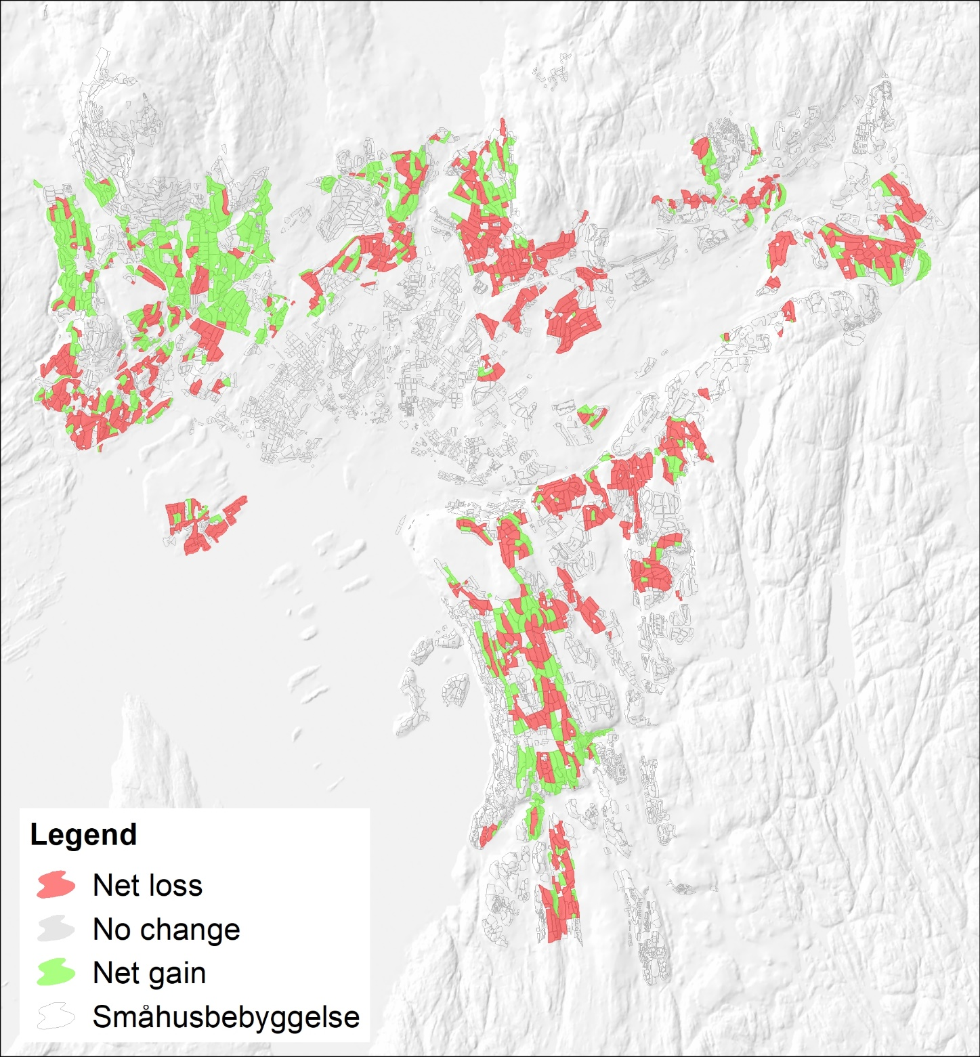
Change in tall trees in the
«Småhusbebyggelse area»
Change in tall trees in the
«Småhusplan area»

Slide 14
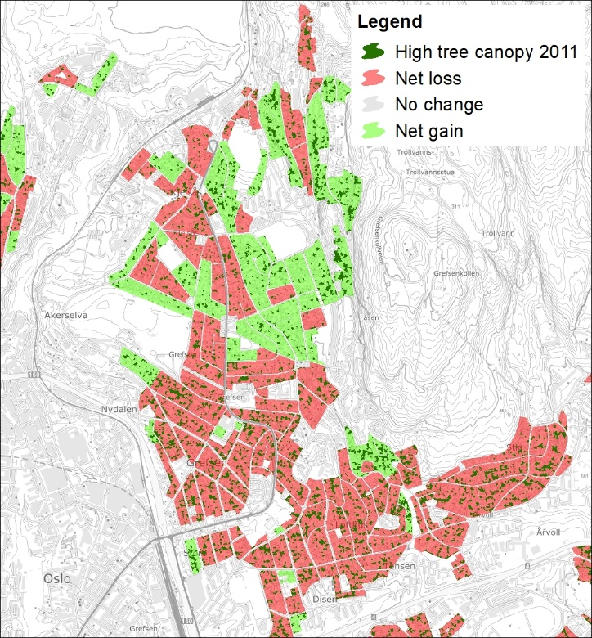
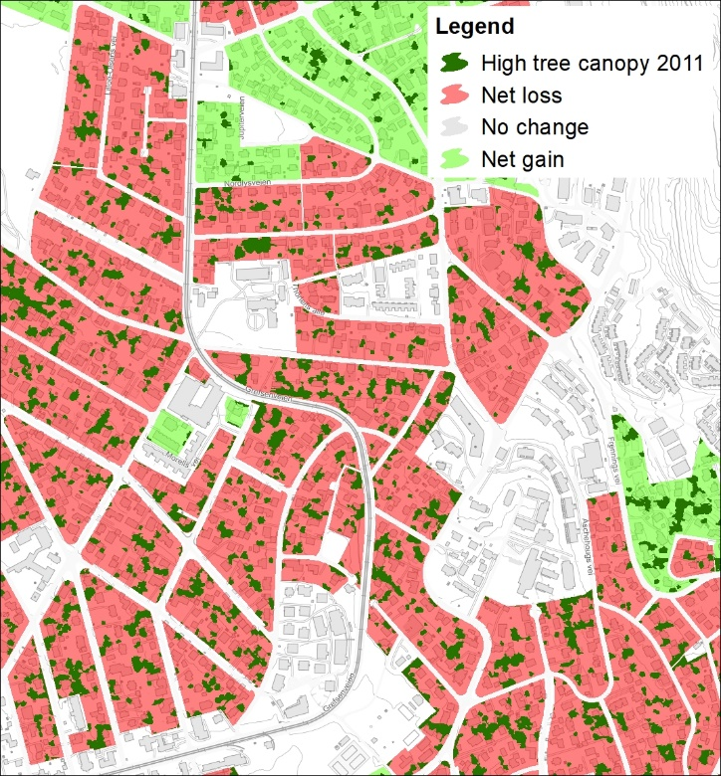
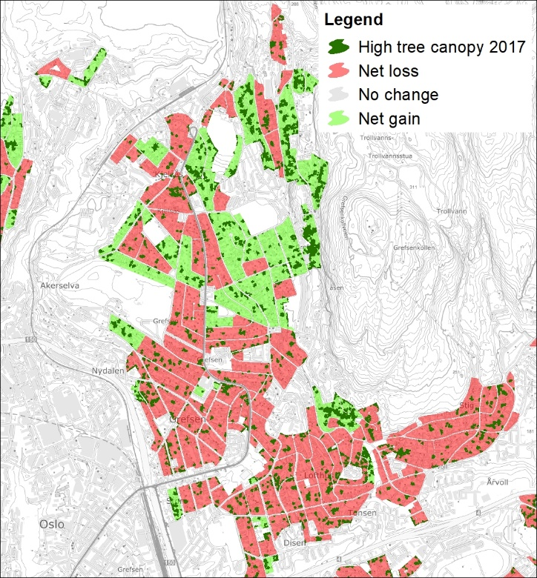
Nordre Aker
Notes:
Dette kan være en indikasjon på at reguleringene i småhusplanområdet på å felle store trær har en effekt.

Slide 15
High
confidence
City level
- Green citywide accounts
City sub-district level
- Green accounts. Neigbourhood level access to greenviews per capita
Public parks & street level
- Inventory of managed trees’ canopy
surface and volume for ecosystem
service estimation
Property level
- Calculating number of trees and
canopy cover for blue-green factor
- Prediction of shading and insolation
Application, limitations and uncertainity
Low
confidence
Single tree level
- Monitoring large trees (“Småhusplan”)

Slide 16
Future LIDAR campaigns should be designed for vege-tation mapping, and combined with IR og hyper-spectral imagery.
Segmentation methods needs to be refined for
tree canopy mapping within an urban environment
Reccomen-dations
More field data is needed for the validation of tree canopy data based on remote sensing data.
We reccomend to migrate future segmentation to cloud computing platforms (e.g. Google Engine) due to its computation capacity.
Foto: Frank Hanssen (CC BY-SA 4.0)

Slide 17
Thank you for your attention!
Questions?
frank.hanssen@nina.no

